Slide 1
INPUT AND OUTPUT DEVICES

Slide 2
COMPUTER
A computer is a programmable machine that is designed to carry out sequences of arithmetic or logical operations automatically. It can execute a pre-recorded list of instructions, known as a program. These instructions can be provided to the computer in various forms, such as input from the user or from a peripheral device.

Slide 3
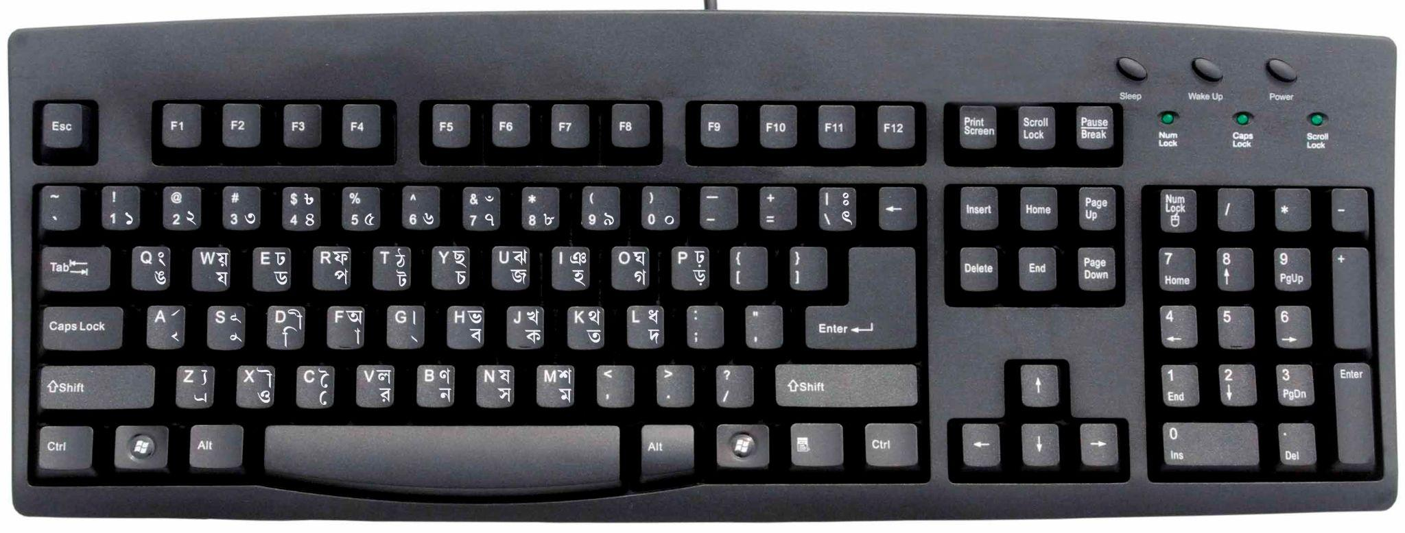
INPUT DEVICES
Keyboard : - used to input words or numbers in computer

Slide 4
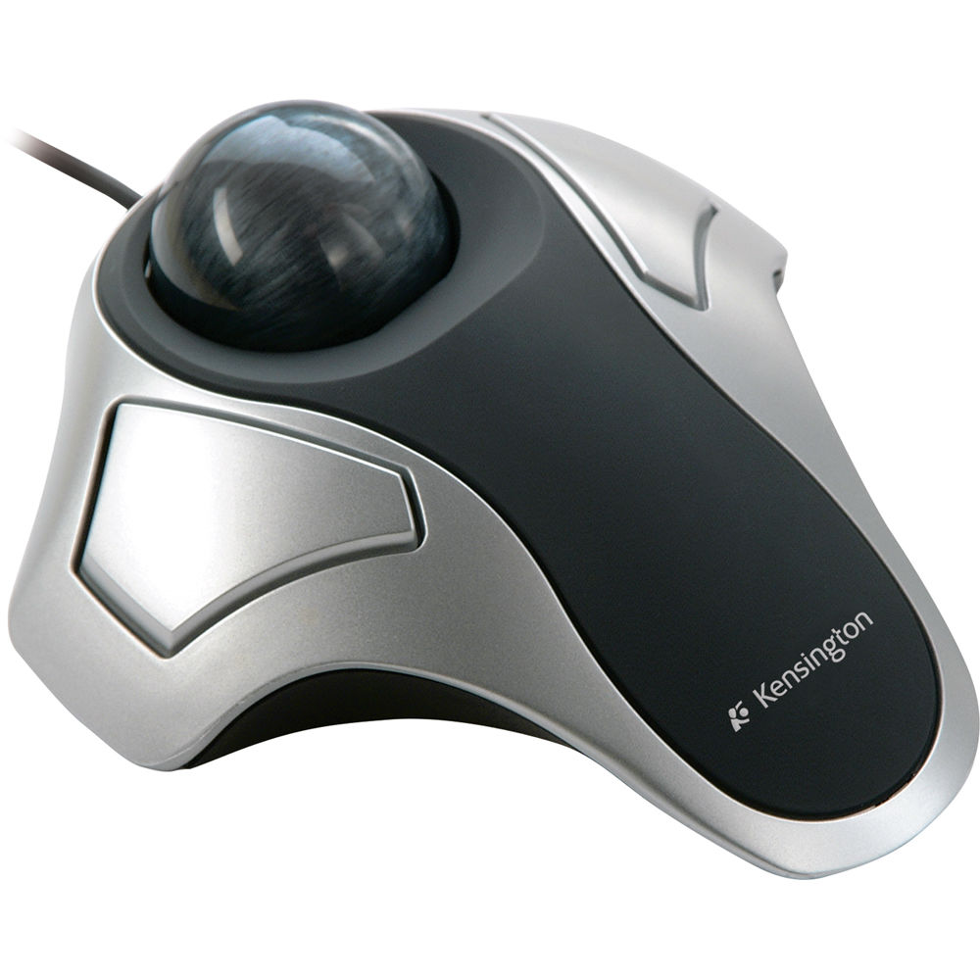
Trackball
n input device that functions as an alternative to a mouse.

Slide 5
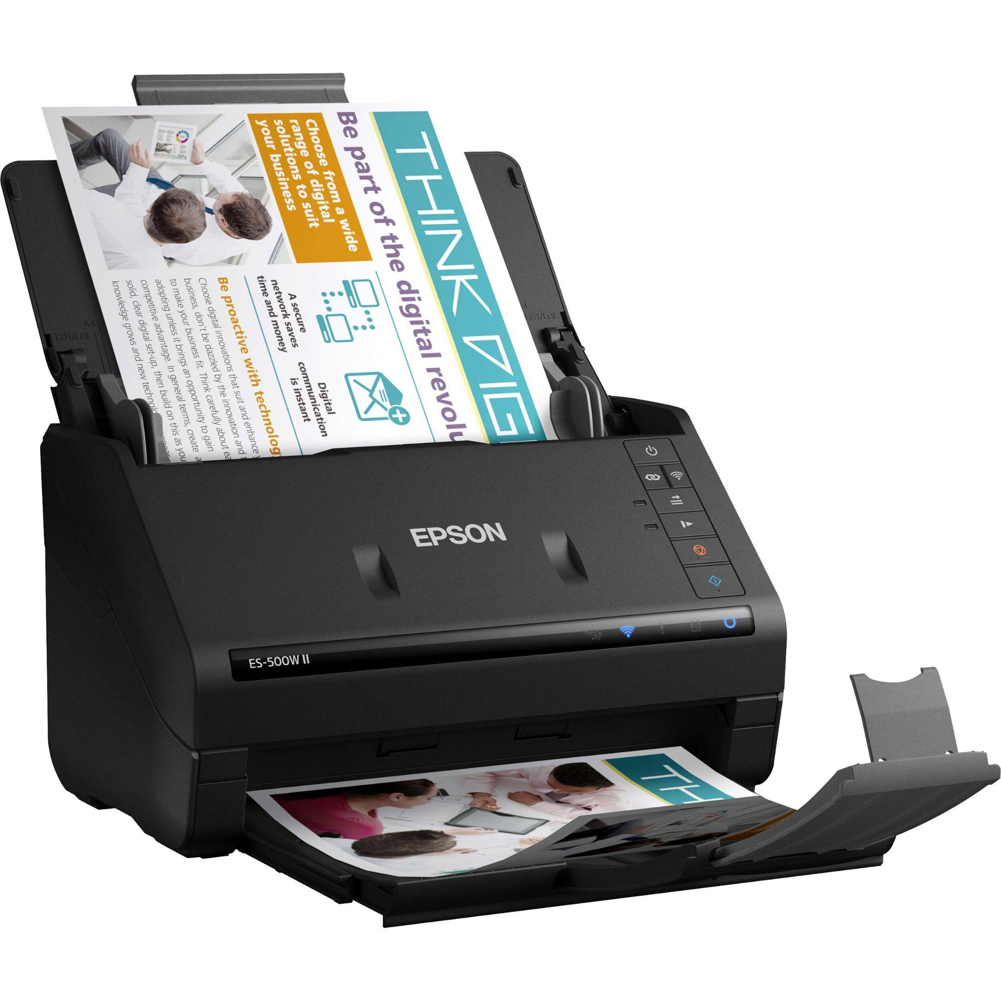
Scanner
A scanner is an input device that captures images, documents, or objects and converts them into a digital format that can be viewed, edited, and stored on a computer

Slide 6
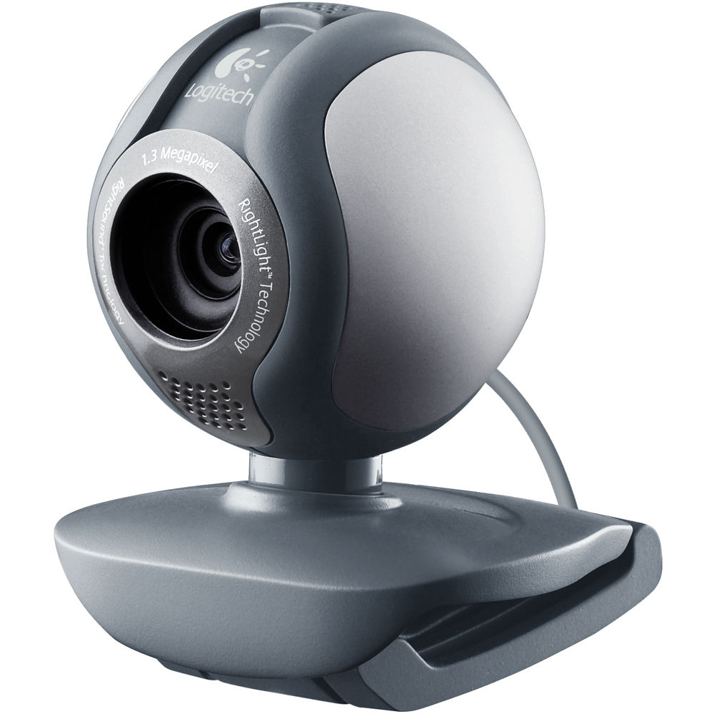
Webcam
A webcam is a video camera that captures and transmits live video and audio to a computer

Slide 7
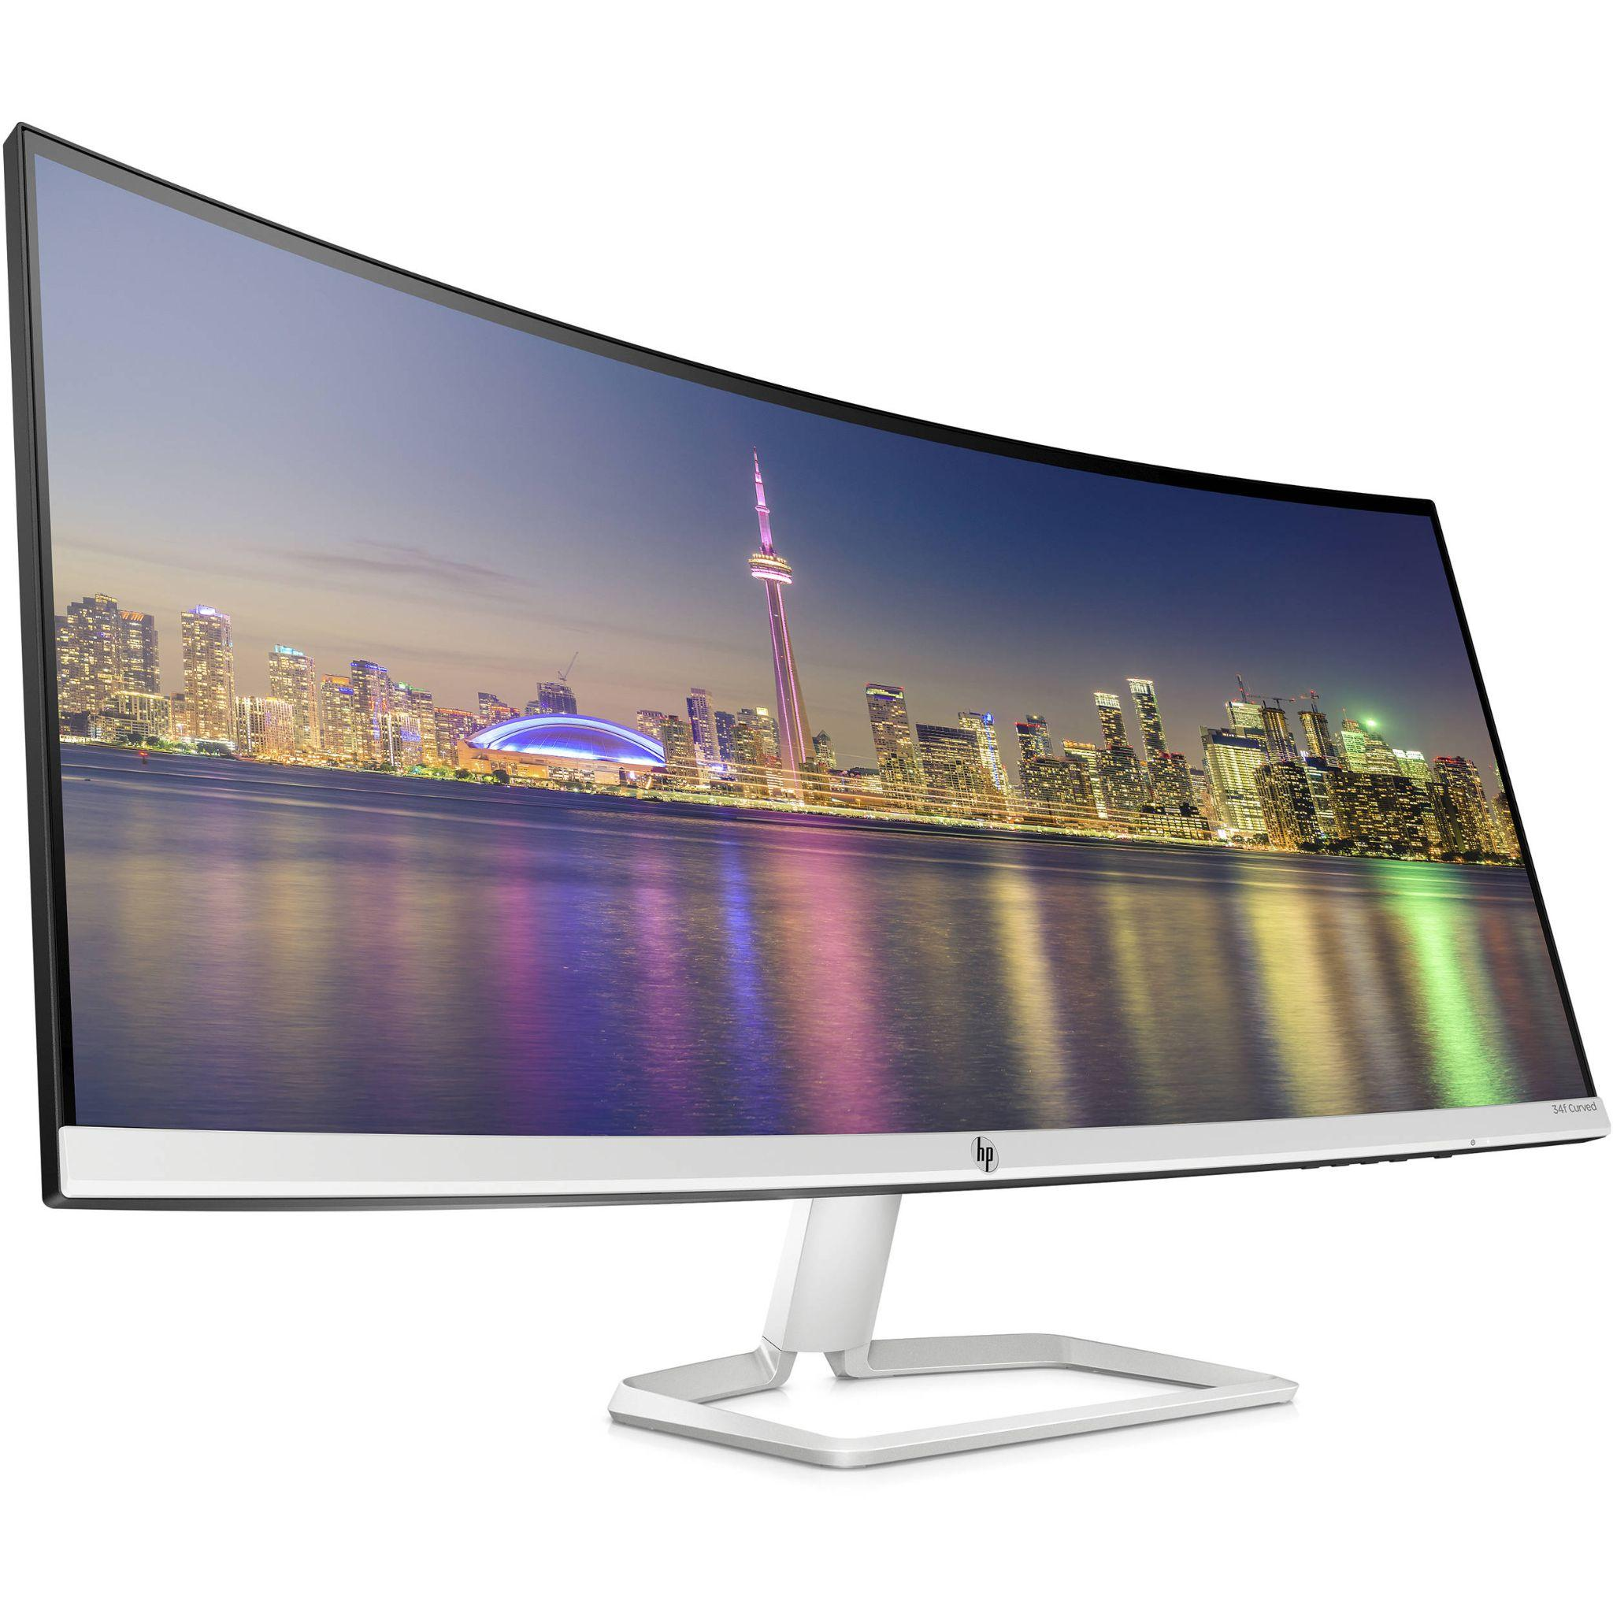
OUTPUT DEVICES
Monitor The primary function of a monitor is to display visual information generated by a computer or other electronic devices.

Slide 8
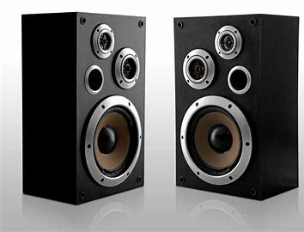
Speakers
Speakers are output devices that convert electrical signals into audible sound, allowing users to listen to audio content, including music, voice recordings, system alerts, and other forms of audio-based information.

Slide 9
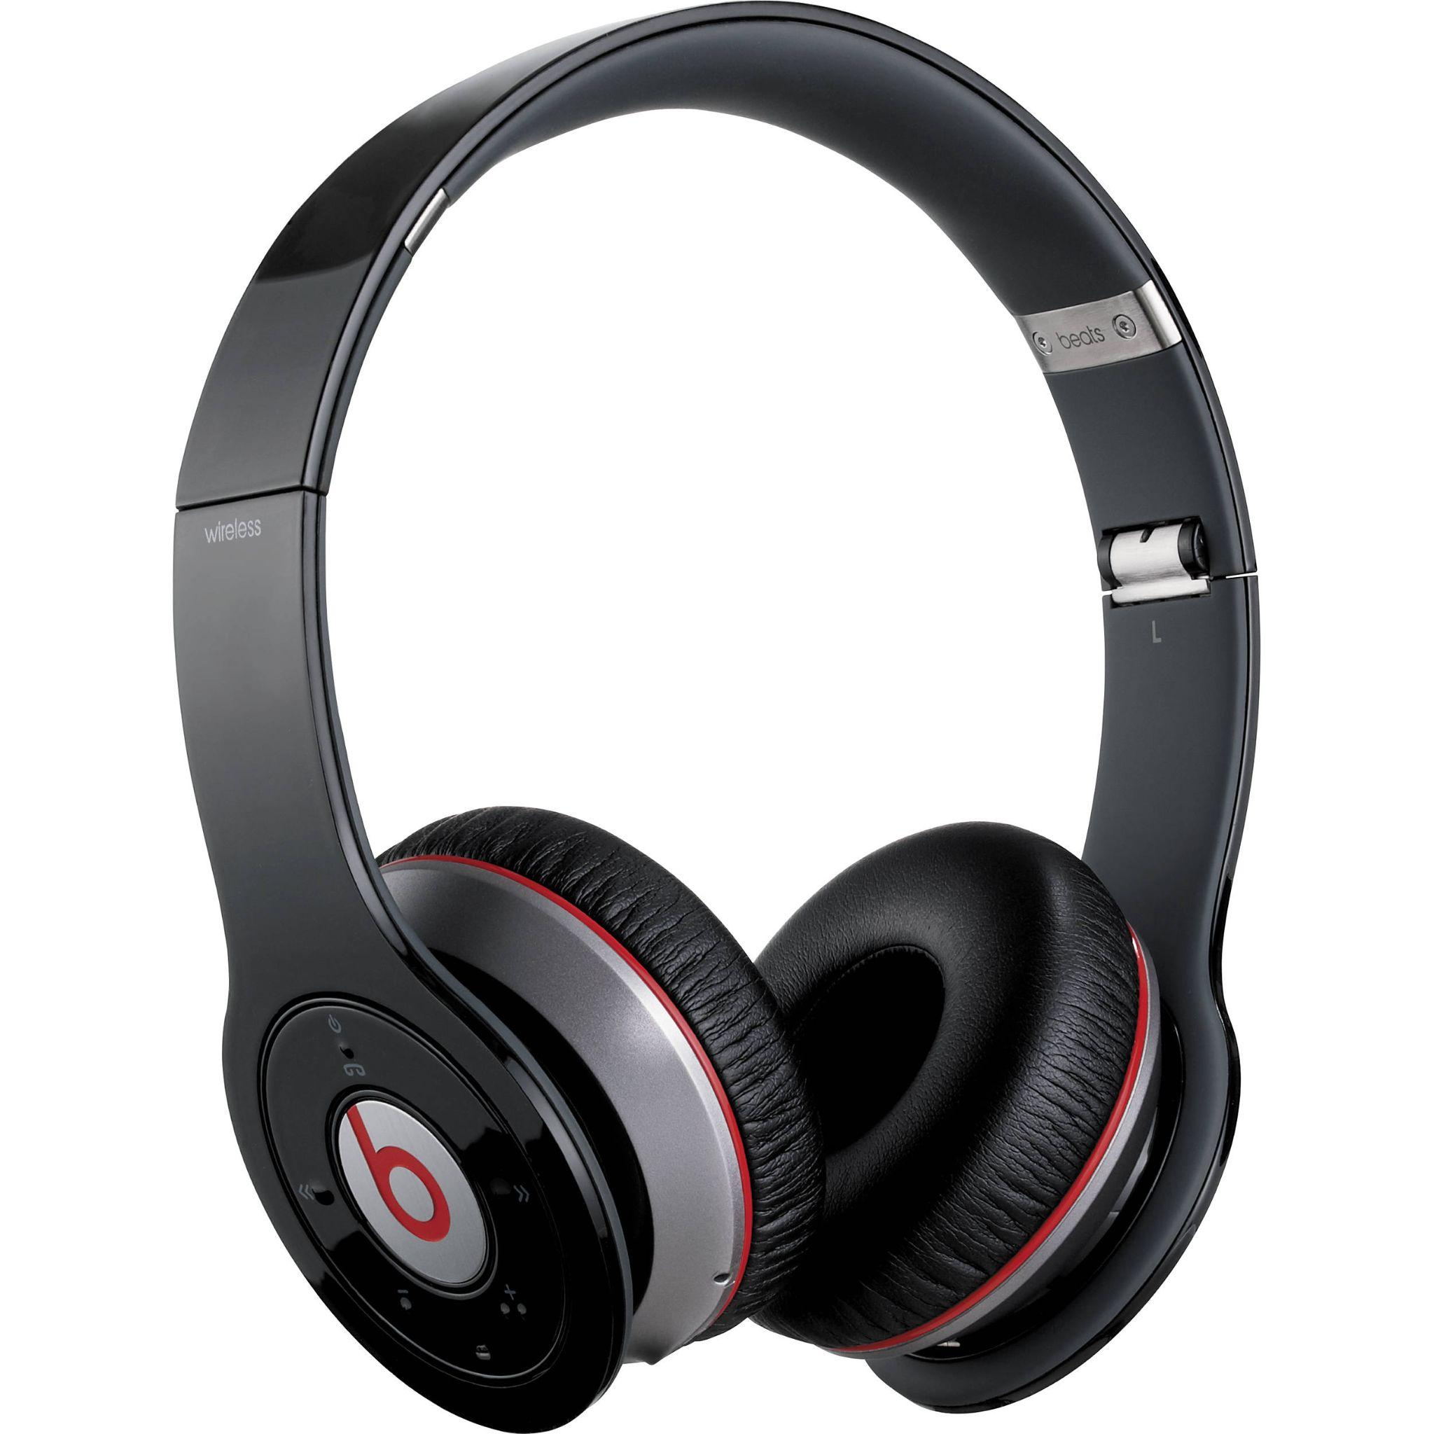
Headphones
Headphones are audio output devices that are worn over the ears or inserted into the ear canal, allowing individuals to listen to audio content privately without disturbing others.

Slide 10
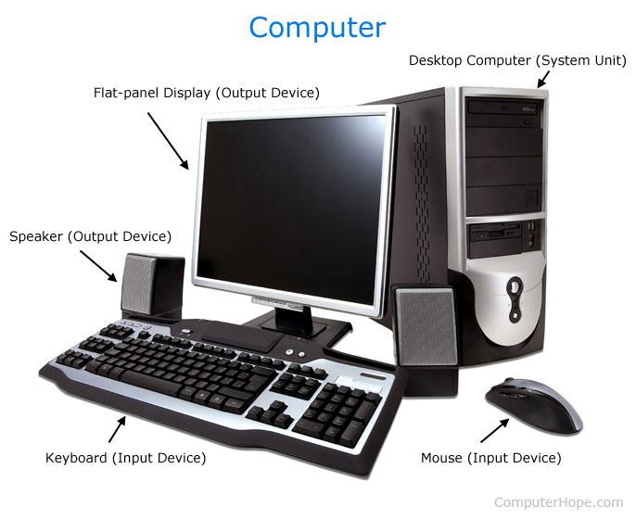
Connectivity of computer and its devices

